Slide 1
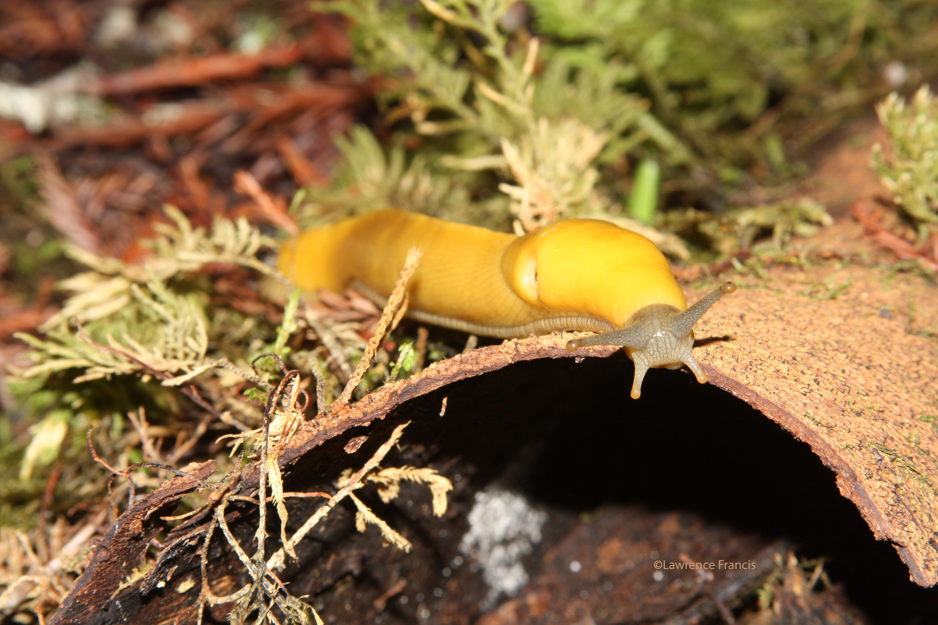
San Joaquin Outdoor School-Jones Gulch
Science Camp in the Redwood Forest

Slide 2
Student Behavior
Just like in a classroom setting, students are expected to respect each other and follow safety guidelines at Science Camp. These rules are designed to help maintain a healthy learning environment at the school.
Consequences
At science camp we use a strike system for misconduct.
Strike 1: Verbal Warning and Write-Up
Strike 2: Written Contract, Restricted from one activity
Strike 3: Written Contract, Call Home, Restricted from one activity
Strike 4: Student is sent home.
Students sent home for discipline will not receive a refund.
Students will wait in the office for their parent to pick them up from Camp

Slide 3
Monday Morning: Leaving for Camp
Students need to be at Ripona at 8:00
They need a brown bag lunch with their name on it
They also need a reusable water bottle
Luggage will be tagged at school
NO TRASH BAG LUGGAGE
NO Electronics or Money
Friday Afternoon: Returning
We leave camp at 10:45
Stop for Lunch around noon
Back to Ripona between 3:00-4:30 (depending on traffic)
You may call the office after 2:00
You need to be at Ripona before the bus arrives to get luggage

Slide 4
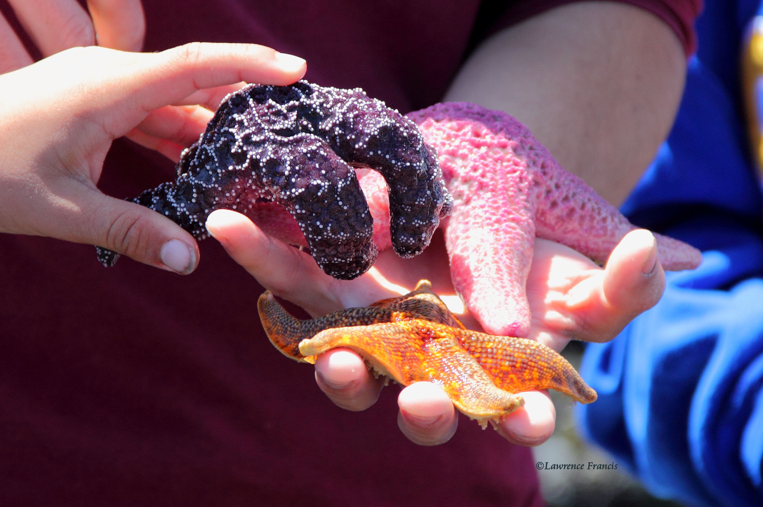
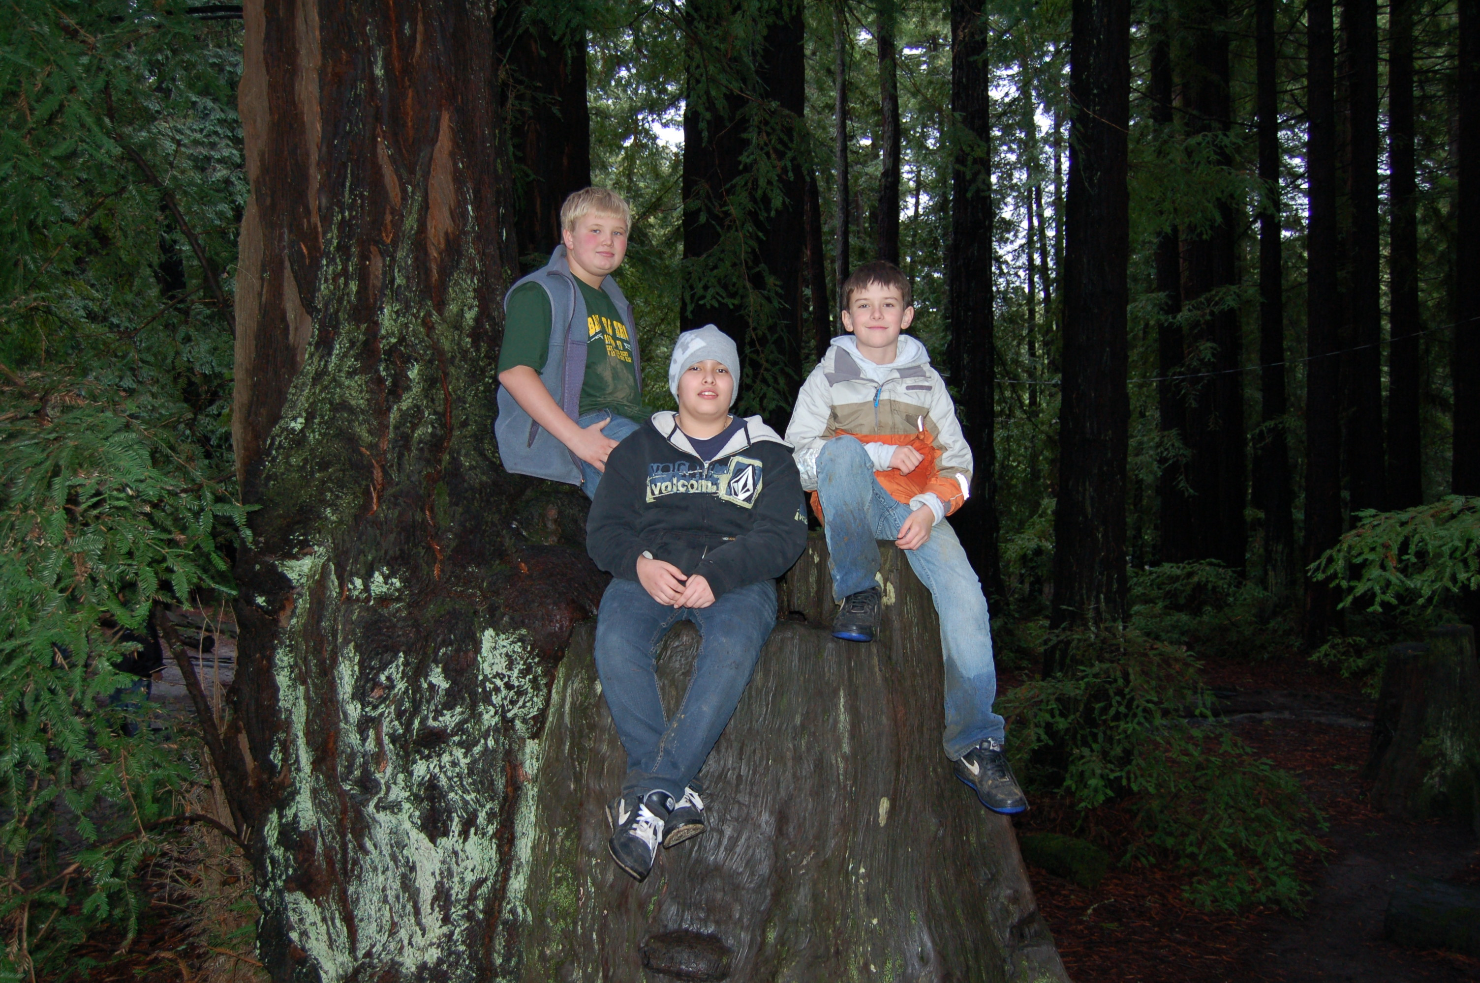
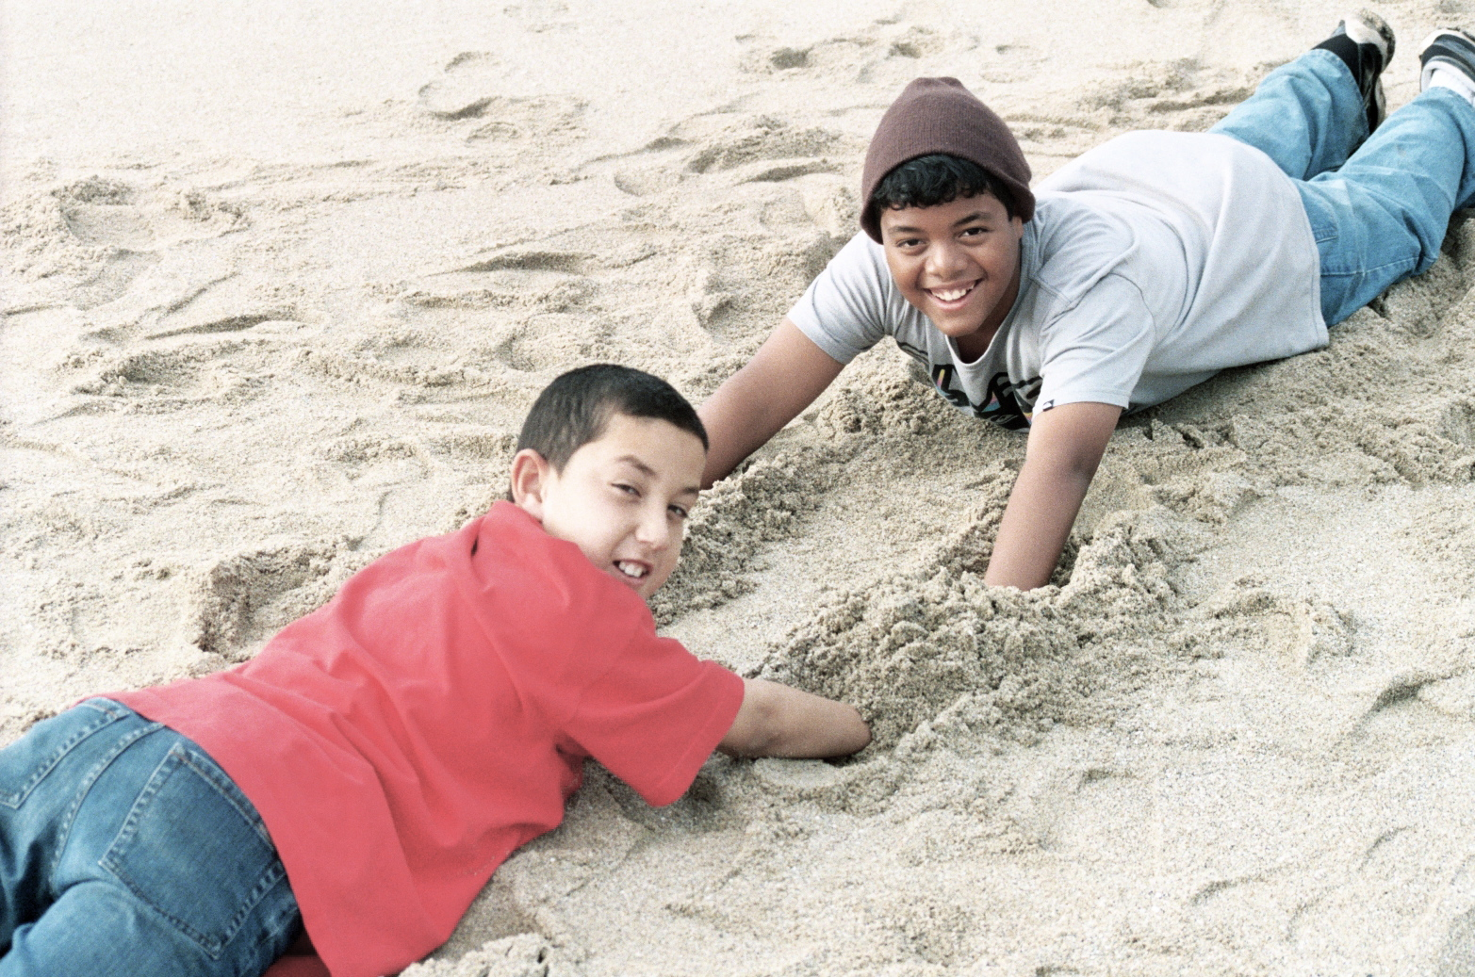
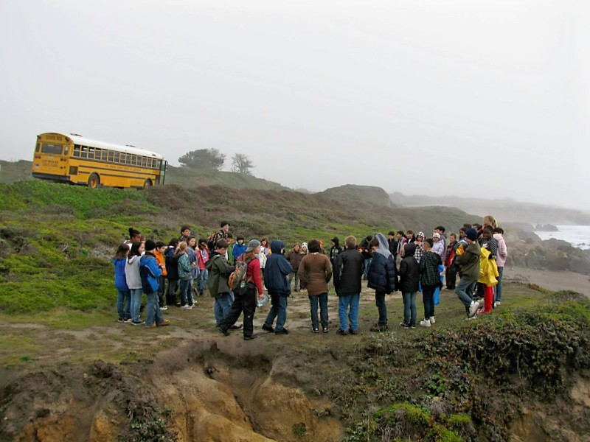
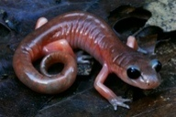
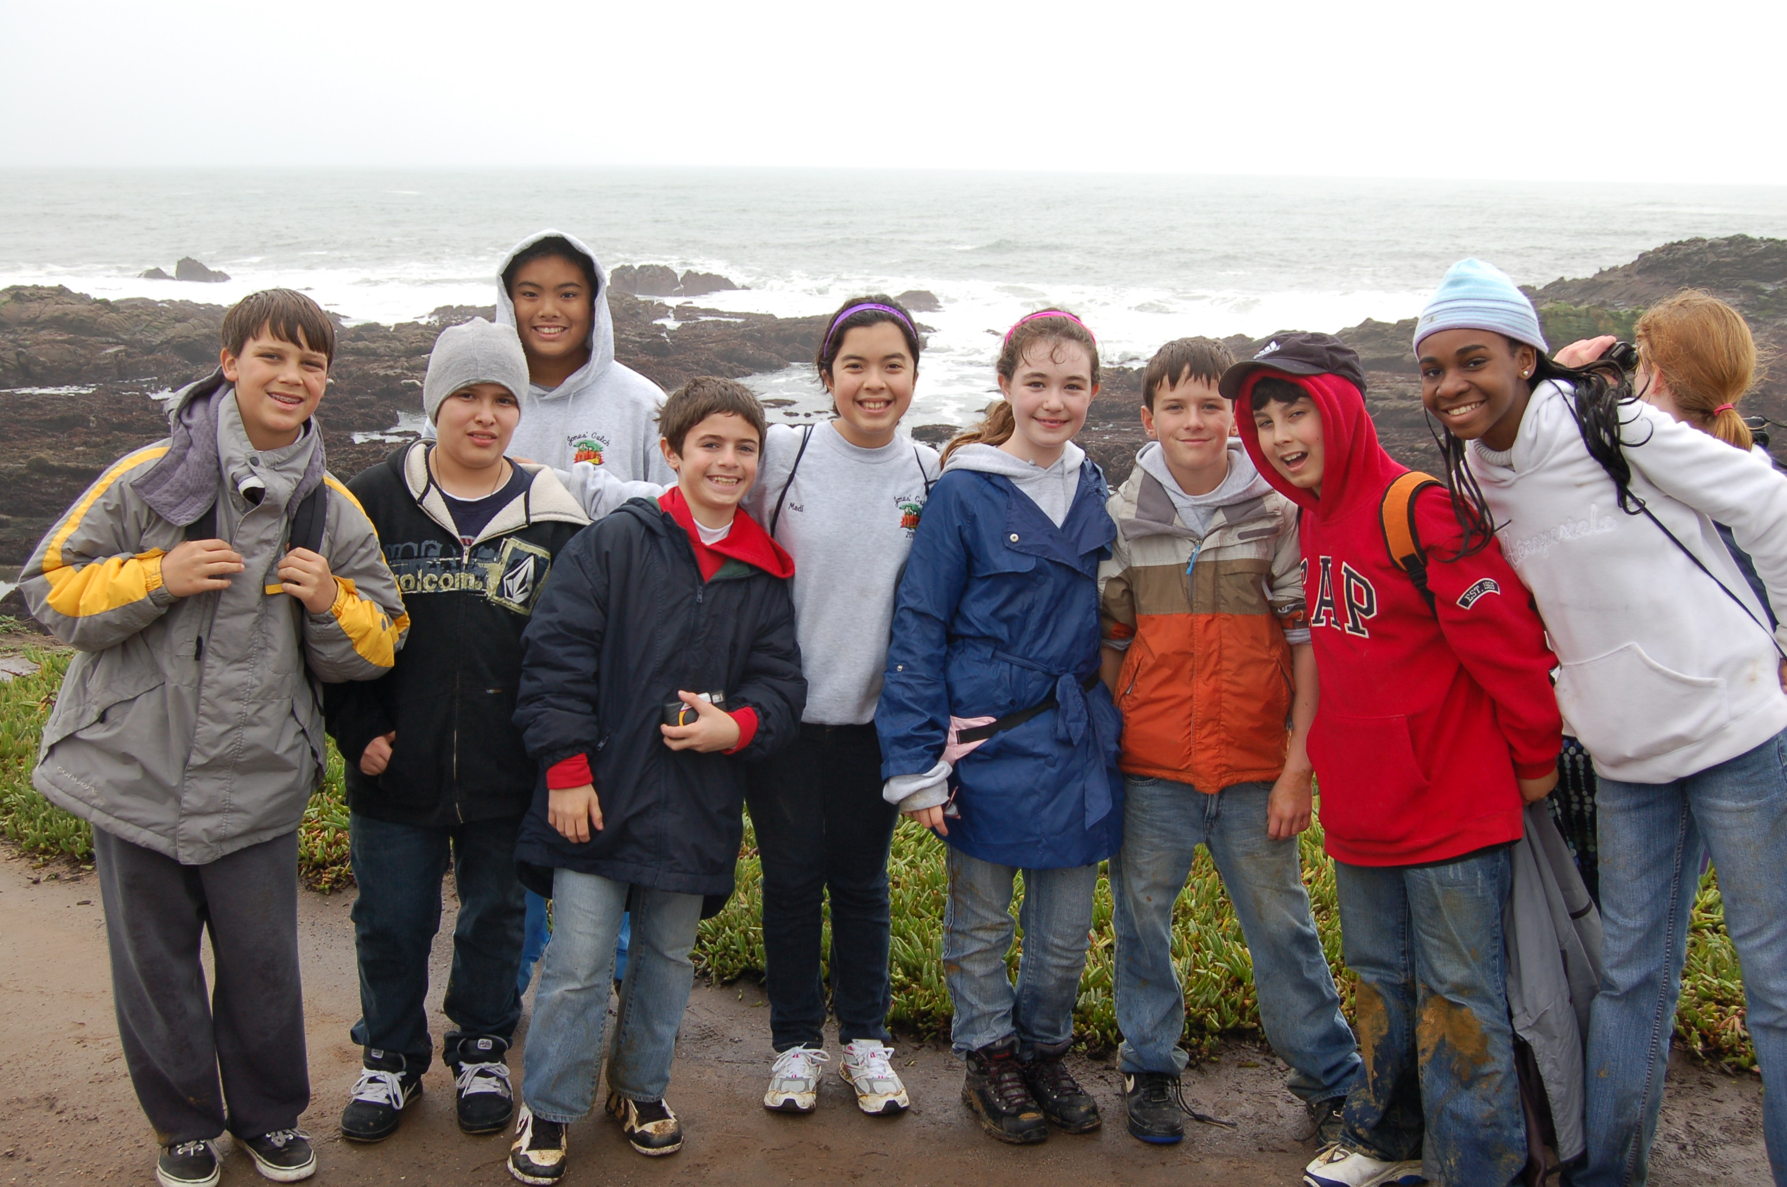
Science Camp Activities
Nature Hikes
Night Hike
Sea Lab
Music Social
Critter Hunts
Shelter Building
Performing Arts Campfire
Fire Building
Nature Art
Teambuilding
Educational Games
Tide pools
Weekly Schedule

Slide 5
Contact Information
Banana Slug Mail
If you want your student to receive mail while at Science Camp, you can either… (A) Send mail with Teachers or (B) A week before your student leaves for Science Camp, using the following address:
Your Child’s Name
San Joaquin Outdoor Education
Week your child is attending (i.e. March 5- March 15)
1100 Pescadero Road
La Honda, CA 94020
Mrs. Gregg & Mrs. Thompson Website
www.outdooreducation.sjcoe.org

Slide 6
Lodging
Students live in cabins with 12-14 campers made up of classmates, as well as students from other schools in attendance.
Students work together to keep the cabin clean, and the teachers perform an inspection daily.
Every cabin group has their own cabin leader; a high school student who is screened and hand picked by the staff at their high school.
Cabins are furnished with mattresses, bunk beds, heaters, nightlights, and bathrooms with showers.
We urge students to bring a sleeping bag, OR sheets and at least 3 blankets, along with their favorite pillow.
If your child wets the bed, please send sheets and blankets rather than a sleeping bag for easier laundering. (If this is an issue, please meet with your child’s teacher privately so that they can inform our staff ahead of time).

Slide 7
Food
Well-balanced meals prepared by excellent cooks are served “family-style”.
We can accommodate for Dietary Restrictions (i.e. vegetarian, allergies, religious, etc.). Please note any issues on the Registration form.
If allergy is serious (i.e. Epinephrine/Benadryl are required), please contact Amy at the County Office prior to your student coming to Science Camp.
DO NOT send any gum, food, or candy.
A complete menu can be found on our website at:
outdooreducation.sjcoe.org

Slide 8
Clothing
Your child should bring the essential items listed in the Science Camp Packet.
Label all clothing with your child’s name and school, especially jackets and other expensive items.
Long pants are required throughout camp to provide better protection on trail hikes.
Clothing will get dirty--do not pack new and/or expensive clothing!
Send two pairs of shoes with your child--they will get dirty and possibly wet!
Send rain pants or jackets if your child has them. We do have ponchos at camp for those without rain gear, but it is helpful if they have their own.

Slide 9
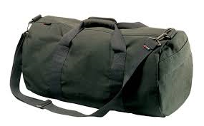
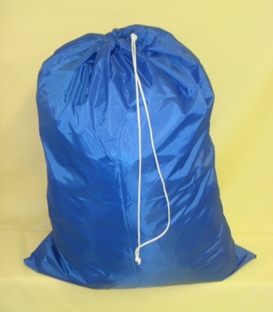
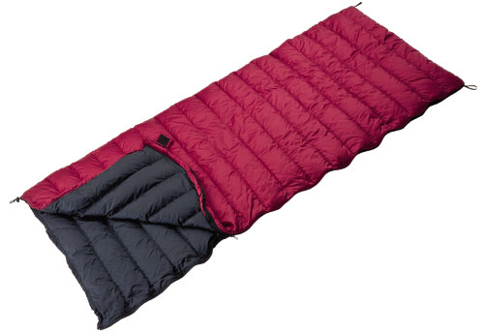
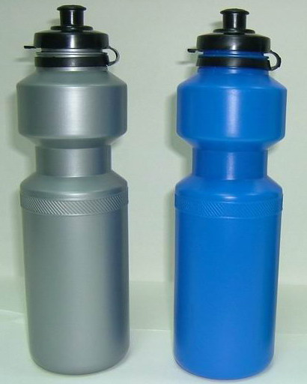
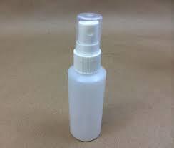
Packing
One average sized duffel bag is enough for clothes
Label all luggage and clothing
Sleeping bag and pillow in a cloth laundry bag
Bring 2 Towels for showers
Pack extra garbage bags for the trip home (for dirty clothes)
Send a water bottle; write name on bottle
NO treats should be packed in your child’s belongings
No Aerosol sprays (Bug Repellent, Deodorant, AXE, etc.)
YES!
NO!

Slide 10
Packing ctd.
DO NOT send luggage with wheels
Students MUST be able to carry all of their own luggage
Students MUST be able to pack their own bags on Friday
Students may bring a backpack, but it has to stay with them during bus trips

Slide 11
Health
We have a residential Emergency Medical Technician on call 24 hours a day.
During the night, cabins are checked by teachers, naturalists and the Evening Site Director.
Office is equipped and prepared for standard health issues.
Parents will be notified of pertinent health conditions.
If a student becomes ill, parents will be called to pick them up.

Slide 12
Medication
For your Child’s Health and our Program’s Longevity,
There are no exceptions to these rules.
Any type of over the counter medications, prescribed medications, or vitamins MUST have a Doctor’s release form.
Prescription over the counter meds, and vitamins will be turned in on the form in your packets.
Epi-pens, inhaled asthma medications, and diabetic medications will be turned in on the form in your packets
Be aware both forms are double sided, and BOTH sides must be filled out.
In addition to physician and parent signature, the Med Form must also have the medication’s name, dosage, and frequency.
For over the counter meds, “As Label Indicates”, is appropriate.
All medications must be sent in the original packaging or in prescribed bottles with your child’s name on it.
These forms must be returned to your child’s teacher two weeks prior to departure.
When packing Meds for camp please place medication in a Ziploc bag labeled with your child’s name.
If you have any questions, please don’t hesitate to call Amy, the SJOE Administrative Assistant. Also, there is additional guidance on our website for sending medications to Science Camp.
•••Please only send medicine that your child absolutely needs•••

Slide 13
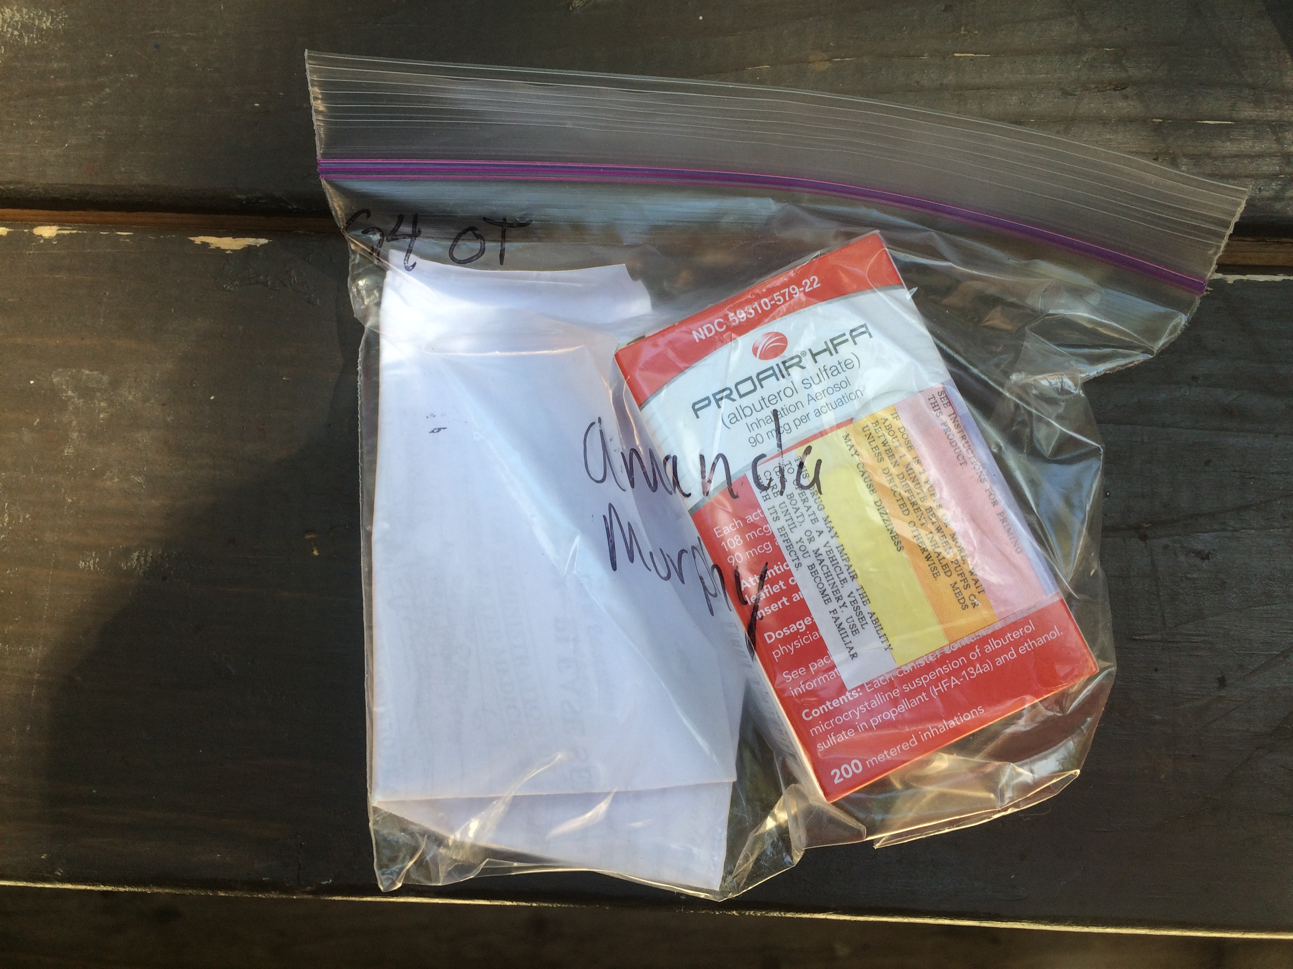

Slide 14
Cost of Camp
Science Camp Cost: $305.00
PFC and office personnel will notify families of cost for individual student as soon as possible
COST WILL BE REDUCED IF YOU FUNRAISED
Recycle Center: 2 sessions of 2 hours: 4 hours in total
Cookie Dough Sales: Sold 6

